Slide 1

DDoS identification and redirection using Machine Learning
School of Computer Science and Engineering
Department of Computer Science and Engineering
Submitted By:
Aditya Swami
2427030177
Supervised By:
Dr. Neha Janu

Slide 2
Outline
Introduction
Literature Review
Problem Statement
Proposed Solution
Objectives
Results

Slide 3
Introduction: DDoS and Machine Learning Approach
Imagine yourself as a business owner and you realize that the website which brings in majority of your business is unreachable because out of no where billions of customers are trying to access your website.
Millions?? That is what we call a DDoS attack where millions of requests start flooding the network by a large number of machines or botnets. The result is service slowdown or outage for users while the attacker gains access to the server.
DDoS attacks aim to break availability, making them especially damaging for e-commerce, finance, cloud services, and critical infrastructure.

Slide 4
Machine Learning in DDoS
Before Artificial Intelligence came into scene, DDoS recognition was based on fixed thresholds, rules and applications which worked for known patterns but didn’t work with 0 day attacks, techniques which keep changing and recent trends.
To address these limitations, researchers and industry systems increasingly use machine learning–based detection, where models learn traffic behavior patterns from data instead of depending only on predefined rules. ML systems analyze features such as flow statistics, packet timing, protocol behavior, and request patterns to classify traffic as normal or malicious.
With machine learning techniques such as random forest, k nearest integers, deep learning DDoS recognition has become easier.

Slide 5
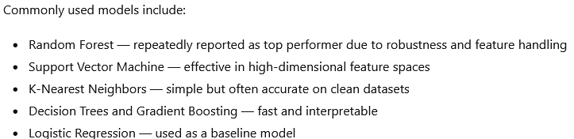
Literature Review: ML-Based DDoS Detection Approaches
A lot of recent studies show accuracy above 98% on different datasets. Different features such as PCA and corelation filtering are being used to improve speed.
Different papers show features like:
. Tree based models often outperform linear models
. Feature engineering strongly affects results
. Model performance varies across datasets

Slide 6
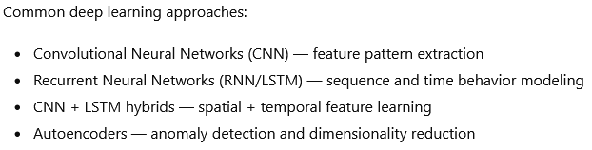
Deep Learning and hybrid models
Recent works are pivoting towards the use of deep learning to capture complex traffic patterns that classical ML may miss. These models are used especially when packet timing, sequence behavior, or multi-feature relationships matter.
Different research trends observed:
. Hybrid models outperform single deep models
. Deep learning improves pattern-based attacks
. Training time, hardware, computational cost are all high as compared to classical ML approach.

Slide 7
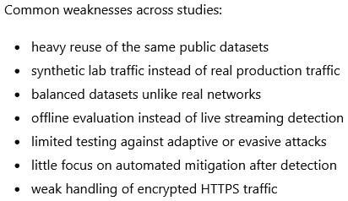
Limitations, issues in existing research
Although the research shows very high accuracy (98% - 99%) there exist several limitations which break the models.
Several other challenges which change dynamically:
. Model drift as traffic patterns change – unable to predict based on what the model has never seen
. False positives – even a small percentage of small positives can lead to huge business losses
. Poor cross-dataset generalization

Slide 8

Problem Statement
Distributed Denial-of-Service attacks continue to grow, targeting both network infrastructure and application-layer services.
Recent machine learning–based detection models report high accuracy on datasets but real-world deployment remains unreliable due to changing traffic behaviour, encrypted protocols, and adaptive attack strategies.
There is a clear gap between high reported detection performance in research and practical, dependable defense in live environments. Current approaches fail to generalize across datasets, struggle with imbalanced and noisy traffic, and provide limited guidance on how detection outputs translate into safe defensive actions.

Slide 9
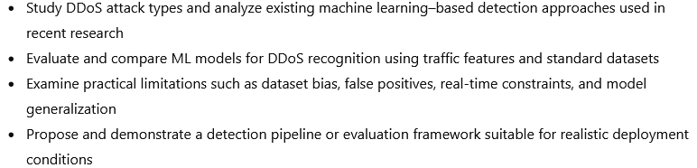
Objectives

Slide 10
Proposed Methodology:
Data Preparation
Use a recent public DDoS traffic dataset with labeled normal and attack flows
Clean the data: remove missing values and duplicates
Extract useful flow features (packet count, rate, duration, flags, etc.)
Normalize values and split into train and test sets
Handle class imbalance so results are not biased

Slide 11
Proposed Methodology:
Feature Selection
Study which traffic features actually help detection
Remove highly correlated and redundant features
Rank feature importance using tree-based models
Test reduced feature sets vs full feature sets
Keep features that work even with limited traffic visibility

Slide 12
Proposed Methodology:
Model Training
Tune key parameters using cross-validation
Compare models using precision, recall, F1 — not just accuracy
Measure training time and prediction speed
Test using unseen data only
Compare model against different models(Random Forest, SVM, boosting)

Slide 13
Proposed Methodology:
Practical Reliability Tests
Test models on imbalanced and noisy data
Check false positive behavior at scale
Evaluate performance when some features are missing
Observe how stable results are under traffic variation
Map detection output to possible defense actions

Slide 14
Result
Model | Accuracy | Precision | Recall | F1 Score | False Positive Rate
Random Forest | 99.1% | 98.8% | 99.3% | 99.0% | 0.9%
SVM | 98.4% | 97.9% | 98.6% | 98.2% | 1.6%
Gradient Boosting | 99.0% | 98.6% | 99.1% | 98.8% | 1.1%
Neural Network | 98.7% | 98.2% | 98.9% | 98.5% | 1.4%

Slide 15
References
https://journals.sagepub.com/doi/abs/10.3233/JIFS-190159
https://pmc.ncbi.nlm.nih.gov/articles/PMC8791701/
https://www.sciencedirect.com/science/article/pii/S1877050924031533
https://onlinelibrary.wiley.com/doi/full/10.1002/eng2.12697

Slide 16
Thank You

